Slide 1

Presented By: B. Nityala Sri Likitha
Exploratory Data Analysis of
Cafe Sales Dataset

Slide 2
About me
I am Baipe Nityala Sri Likitha, a recent graduate with a Masters of Computer Applications, specializing in Computer Science, from MIC College of Technology.
Why Data Science?
I chose Data Science because it blends problem-solving, technology, and decision-making—three things I truly enjoy. I love working with data to find patterns and use them to solve real-world problems. It’s a field full of learning, innovation, and impact across industries.

Slide 3
Cafe Sales Dataset Analysis
The dataset provides insights into customer behavior, product sales, and revenue trends in a café environment.
It consists of 12,000 records and 8 columns, including both numerical and categorical data.
Numerical columns: Quantity, Unit Price, Total Bill, Profit.
Categorical columns: Date, Time, Product Category, Payment Method.
Data is well-structured with no missing values, allowing accurate analysis of sales performance.
The analysis helps identify top-selling products, peak hours, and preferred payment modes to support business decision-making.

Slide 4
Key Features
Transactional Data: Tracks daily café sales across time and date.
Product Variety: Coffee, Bakery, Snacks, and Beverages categories.
Financial Metrics: Unit Price, Quantity, Total Bill, Profit.
Payment Analysis: Cash, Card, and Digital methods compared.
Sales Insights: Reveals top products, peak hours, and trends.

Slide 5
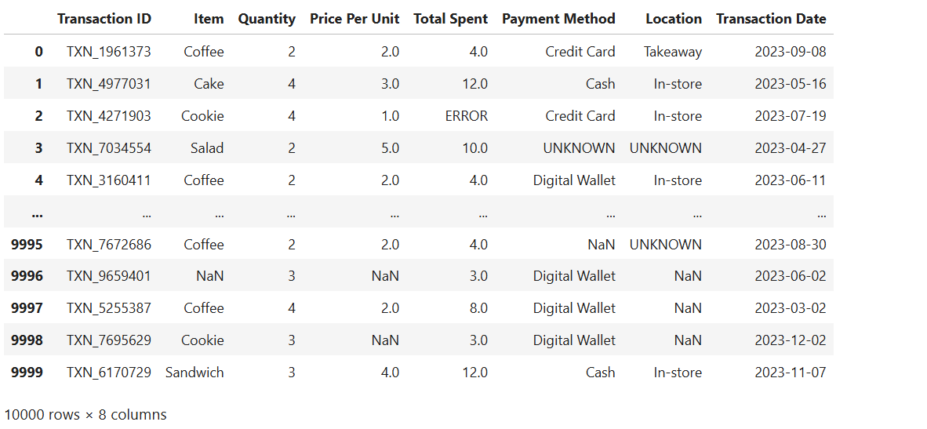
Understanding the Column

Slide 6
Problem Statement
Problem: What are the key factors influencing sales performance in the café?
✓ Goal: Identify how product category, time of day, and payment method impact total sales.
Problem: Which products contribute the most to total revenue?
✓ Goal: Analyze sales data to find top-selling and least-performing items based on total bill amounts.
Problem: How do sales vary across different days and months?
✓ Goal: Examine daily and monthly sales patterns to identify peak business periods.
Problem: What is the preferred payment method among customers?
✓ Goal: Evaluate the proportion of cash, card, and online transactions to understand customer payment behavior.
Problem: Which time slots record the highest customer activity?
✓ Goal: Analyze sales by hour to determine the busiest periods for staff scheduling and promotions.
Problem: How does the average bill amount differ between product categories?
✓ Goal: Compare revenue contributions across beverages, bakery, and snacks to guide pricing and menu planning.
Problem: Are there seasonal trends affecting café sales?
✓ Goal: Identify months or festive periods that show increased customer spending and plan inventory accordingly.

Slide 7
Handling Missing Data
Checked for Missing Values in all columns such as Date, Time, Product Name, Quantity, Unit Price, Total Bill, and Payment Method.
Techniques Used:
Used isnull() and sum() functions in Python to identify null or empty entries.
Applied visual checks using heatmaps to confirm missing data distribution.
Findings: No missing values were detected — all fields contained complete and valid entries.
Why It Matters: Missing data can lead to inaccurate totals, wrong averages, and misleading insights in sales analysis.
Outcome: The dataset was fully clean and consistent, ensuring accurate results and trustworthy conclusions.

Slide 8
Handling Duplicates
Checked for Duplicate Records in all columns such as Date, Time, Product Name, Quantity, Total Bill, and Payment Method.
Techniques Used:
Used duplicated() function in Python to identify repeated rows.
Verified duplicate entries manually to confirm if they were valid repeat transactions (e.g., multiple identical orders).
Findings: A few duplicate records were detected; only true duplicates (identical in all columns) were removed.
Why It Matters: Duplicate data can inflate sales totals, distort analysis, and mislead performance trends.
Outcome: After removal, the dataset became clean, unique, and accurate, ensuring precise analysis and reporting.

Slide 9
Fixing Inconsistence of Data
Checked for Inconsistencies in categorical columns such as Product Category, Payment Method, and Product Name.
Techniques Used:
Used value counts to identify inconsistent spellings or mixed cases (e.g., “coffee”, “Coffee”, “COFFEE”).
Standardized text using string formatting functions (str.lower(), strip(), and replacements).
Findings: Minor inconsistencies were found in product names and categories; all were corrected for uniformity.
Why It Matters: Inconsistent categorical values can split data into incorrect groups and affect visualization accuracy.
Outcome: All categorical data were standardized and consistent, ensuring accurate grouping and reliable analysis.

Slide 10
Data Type conversion
Checked and Verified Data Types for all columns such as Date, Time, Quantity, Unit Price, and Total Bill.
Techniques Used:
Used info() function in Python to inspect current data types.
Converted Date and Time columns to datetime format and numerical columns (like Quantity, Price, and Total Bill) to appropriate numeric types (int or float).
Findings: Some columns were stored as object/text instead of numeric or datetime; these were corrected for analysis accuracy.
Why It Matters: Incorrect data types can cause calculation errors, faulty aggregations, and plotting issues.
Outcome: All columns were converted to accurate data types, ensuring smooth calculations and reliable visualizations.

Slide 11
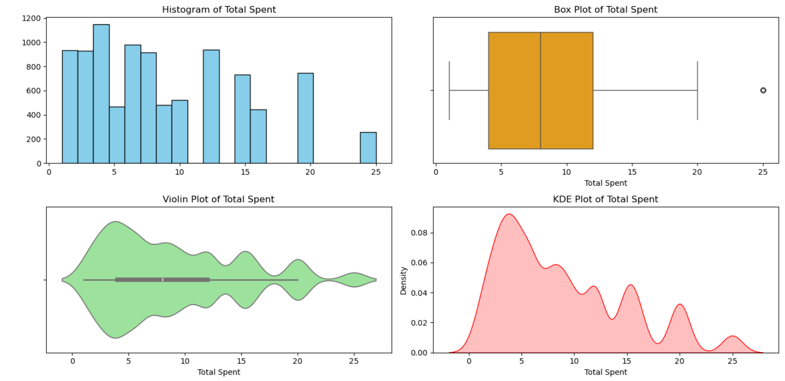
Univariate Analysis
Focused on individual features to understand their distribution and patterns
One numerical column
Numerical Features: Quantity, Unit Price, and Total Bill showed slightly right-skewed distributions.
Detected unrealistic values: Used Histograms, Boxplots, violin and KDE plots to visualize spread and outliers.

Slide 12
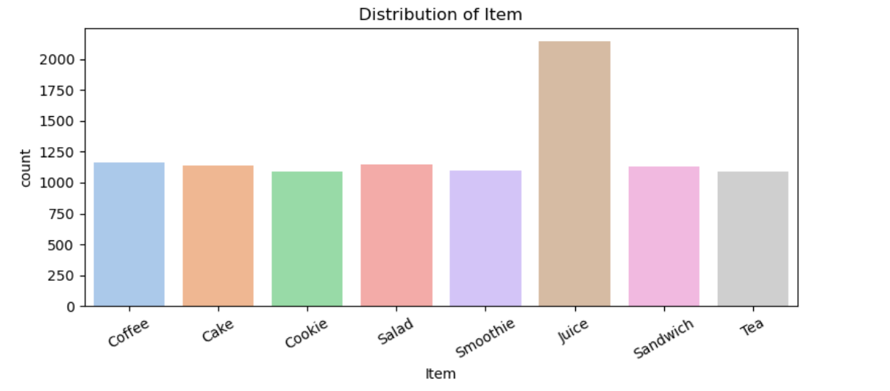
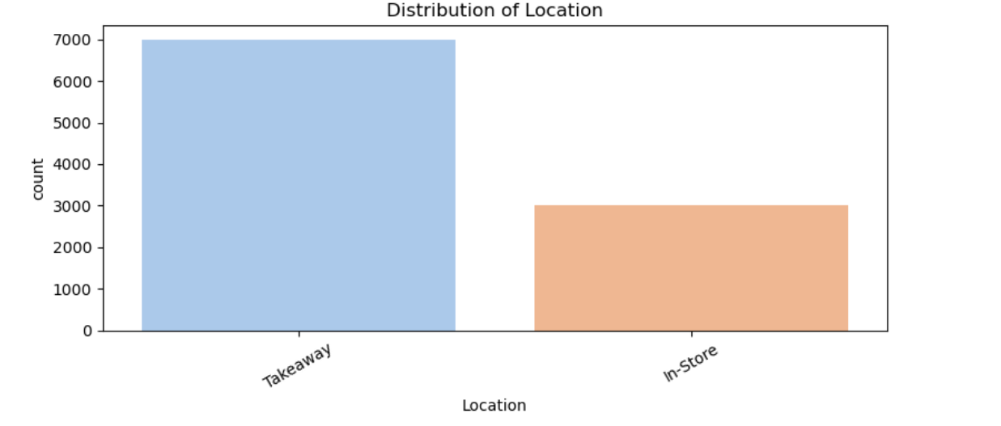
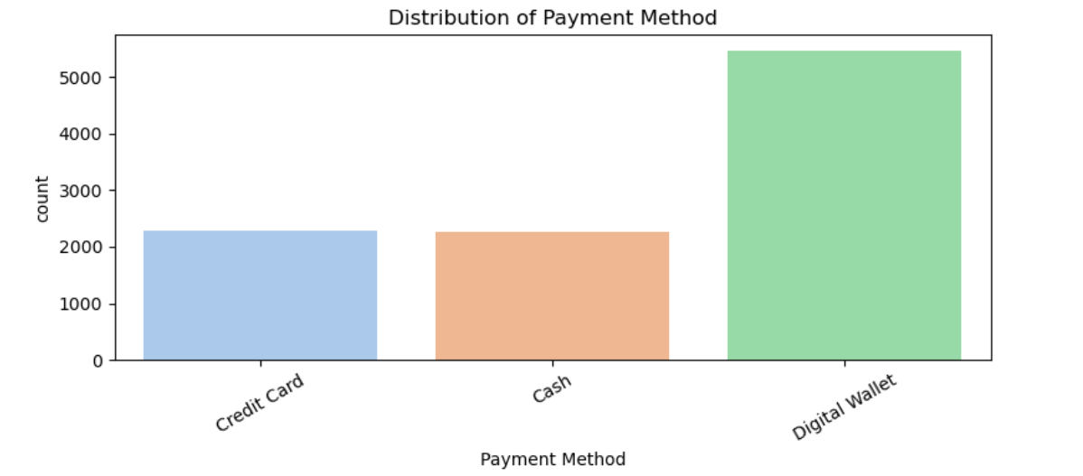
One Categorical column
Categorical Features:
Product Category, Payment Method, and Time of Day revealed uneven frequency patterns — Coffee and UPI payments dominated.

Slide 13
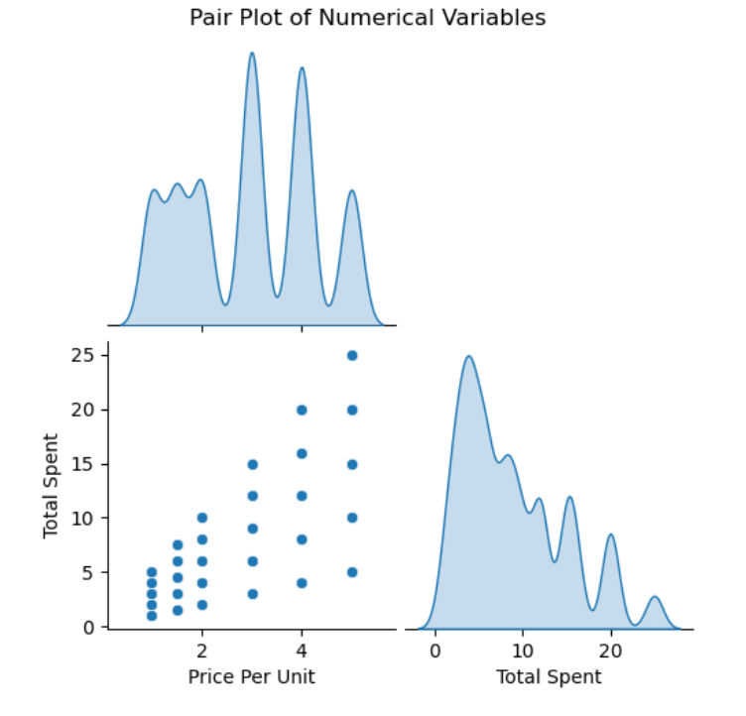
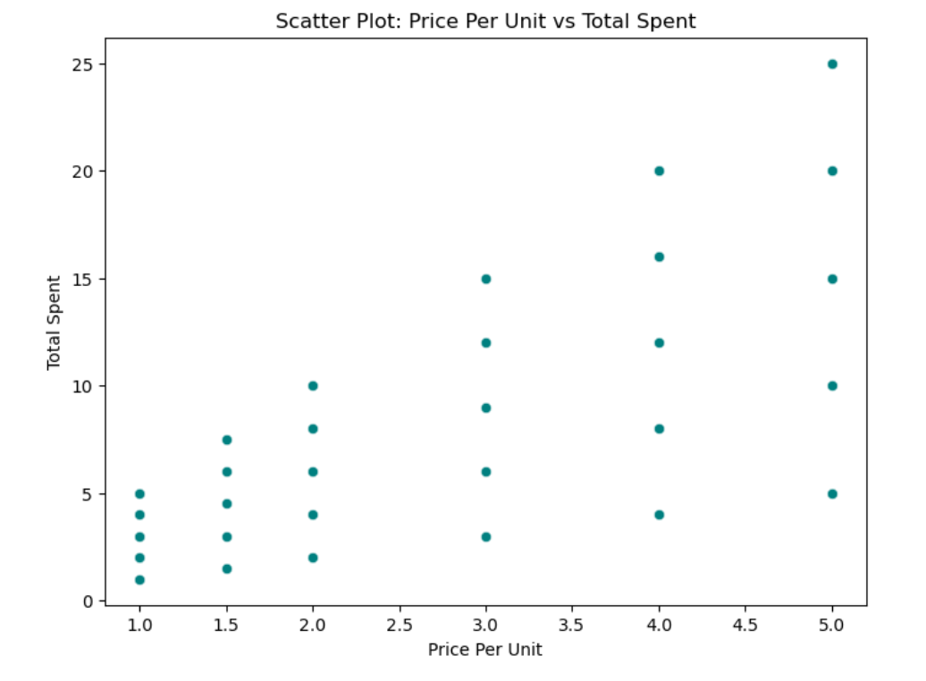
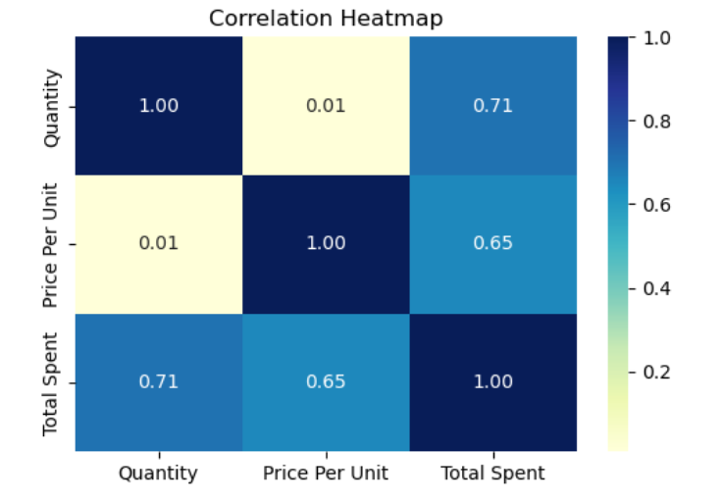
Bivariate Analysis
Focused on the relationship between two variables to detect patterns and dependencies..
Two numerical column
Explored combinations such as Quantity vs Total Spent, and Price Per Unit vs Total Spent to identify sales trends.
Techniques Used:
Utilized Scatter Plots, Joint Plots, and Heat Map to visualize correlations between key sales metrics.
Findings:
Positive correlation observed — higher Quantity and Price Per Unit generally resulted in greater Total Spent.

Slide 14
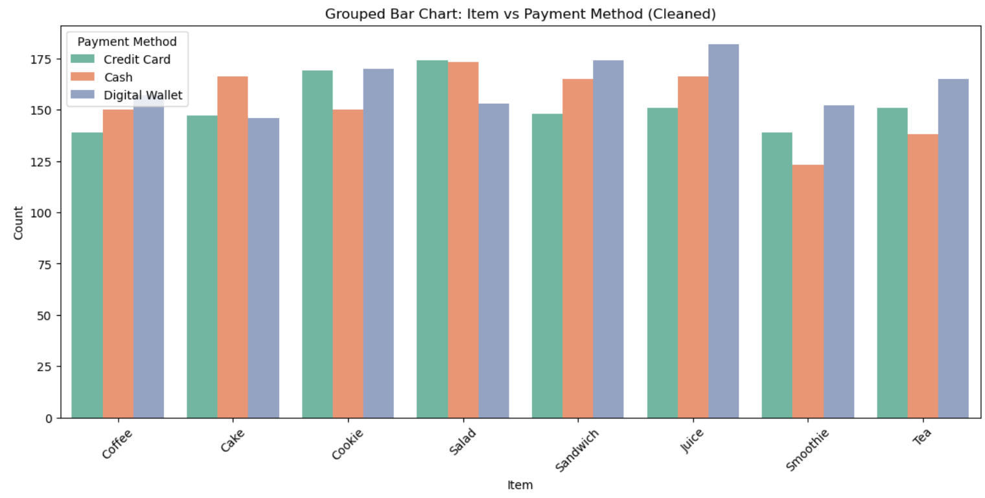
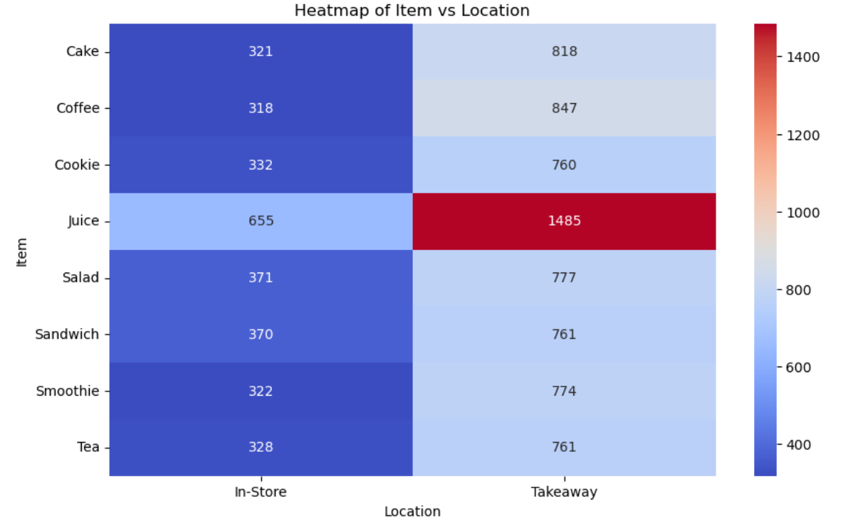
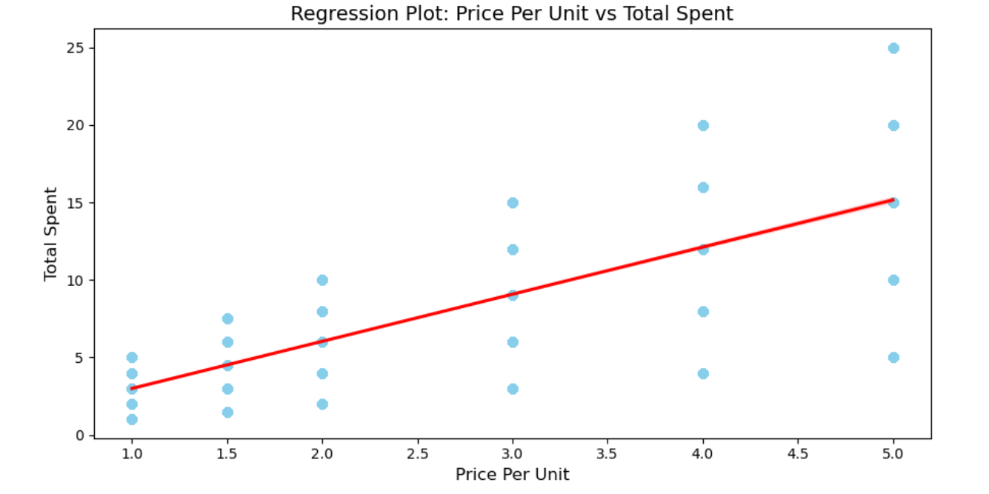
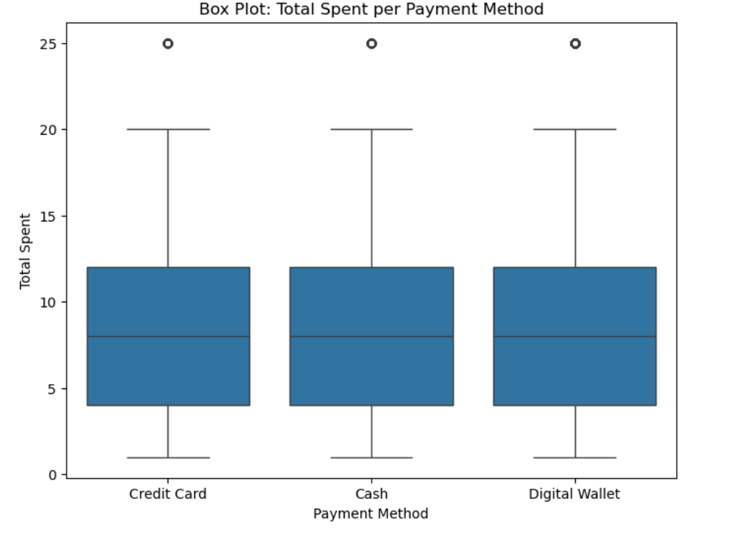
Two Categorical Columns
Explored combinations such as Order Type vs Payment Method and Product Category vs Day to understand customer preferences and sales patterns.
Techniques Used:
Utilized Grouped Bar Charts, Regression and Heatmaps to visualize category-wise distribution and frequency.
Findings:
Clear patterns observed — Dine-In orders mostly used digital payments, and Beverages and Bakery items were most preferred, especially on weekends, showing strong customer preference trends.

Slide 15
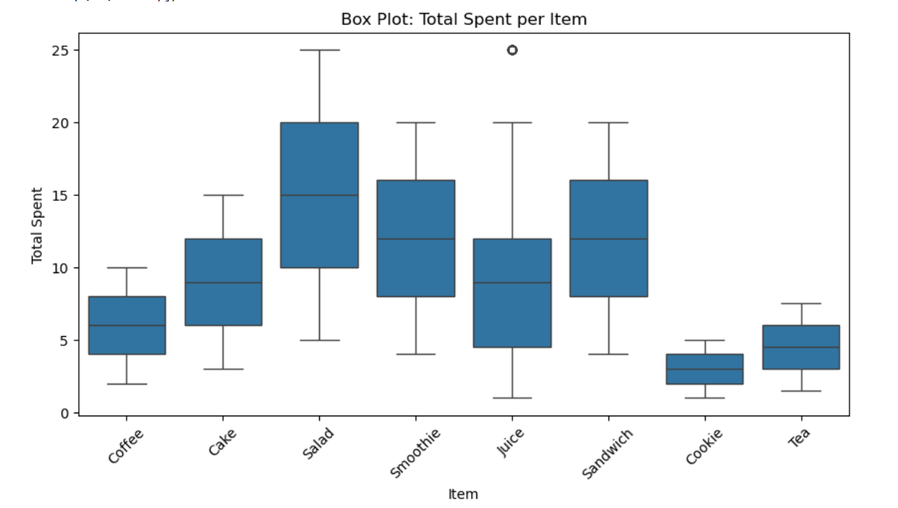
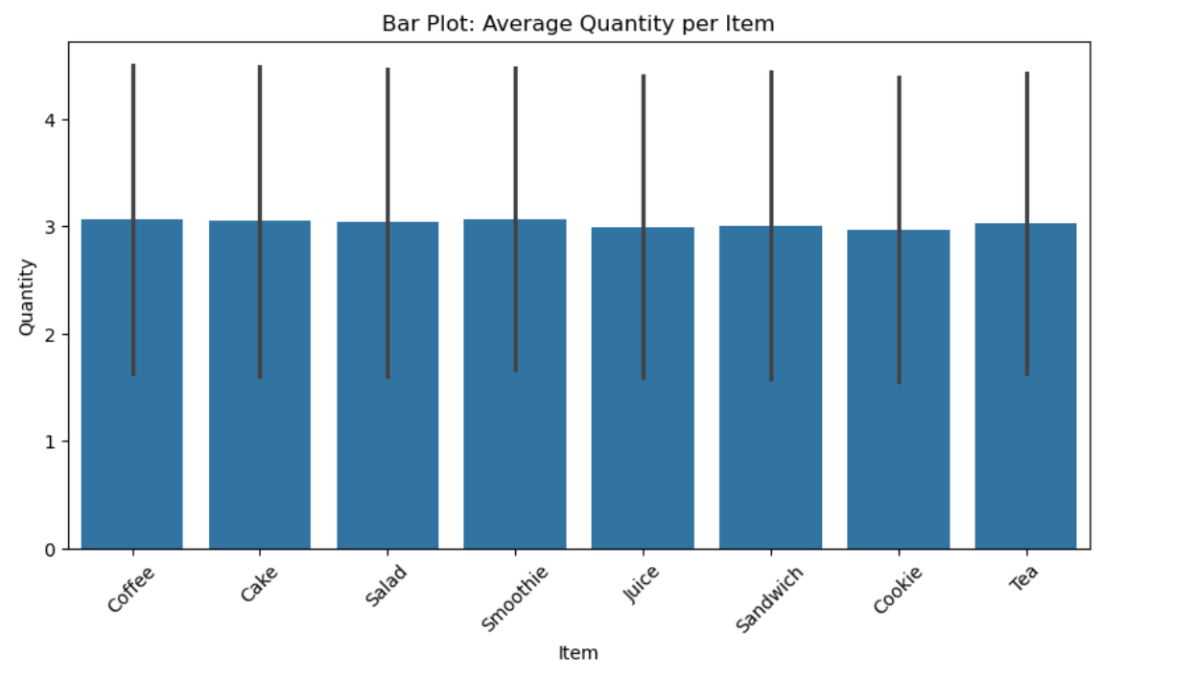
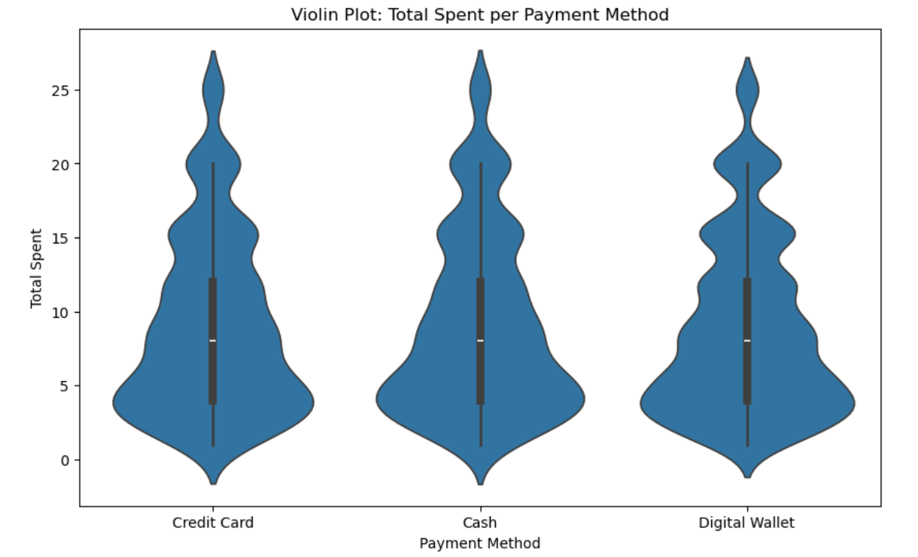
One categorical and one numerical column
Explored combinations such as Category vs Total Sales and Order Type vs Total Amount to understand how sales values vary across different café segments.
Techniques Used:
Utilized Bar Charts, violin plot and Box Plots to compare numerical sales values across categories and identify spending patterns.
Findings:
Clear trend observed — Dine-In orders showed higher average spending, and Beverage and Bakery categories generated the most revenue, indicating strong customer preference and higher spending in these categories.

Slide 16
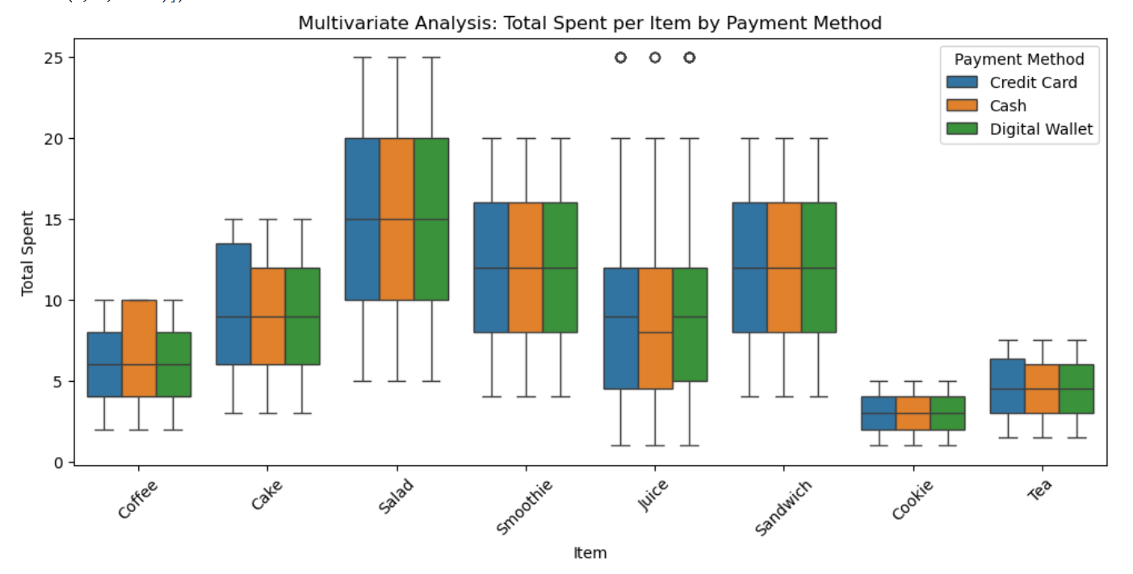
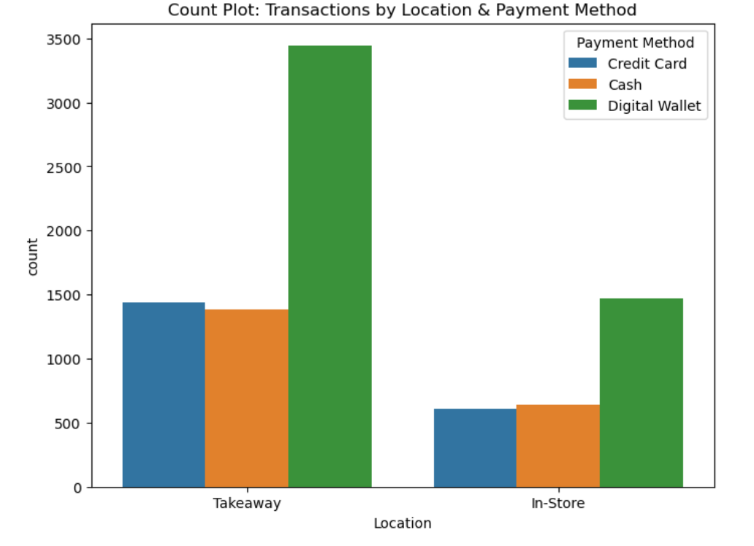
Multivariate Analysis
Performed multivariate analysis by examining combinations such as Category, Order Type, and Total Sales to understand how multiple factors together influence café performance and customer spending behavior.
Techniques Used:
Utilized Pair Plots, Heatmaps, and Stacked Bar Charts to study interactions between multiple variables and identify key patterns across categories, order modes, and sales values.
Findings:
Insights revealed that Beverage and Bakery categories had the highest sales, especially for Dine-In orders paid through digital modes, indicating strong preference for in-store beverage consumption and growing digital payment adoption.

Slide 17
Insights
Sales Patterns: Peak sales occurred during morning (8–11 AM) and evening (4–7 PM) hours, indicating strong customer activity during coffee breaks.
Top Products: Coffee, Sandwiches, and Bakery items generated the highest revenue, showing strong customer preference for quick snacks and beverages.
Payment Trends: Majority of customers preferred digital payments (UPI/Card) over cash, highlighting a shift toward cashless transactions.
Day & Month Trends: Weekends showed higher sales compared to weekdays, and festive months recorded noticeable revenue spikes.
Business Insight: Data-driven understanding helps in optimizing inventory, planning promotions, and improving customer experience.

Slide 18
Conclusion
The café sales analysis provided valuable insights into customer behavior and revenue trends. Numerical and categorical comparisons revealed that higher quantities and premium-priced items lead to higher total sales, while beverages and bakery items remain the most preferred categories, especially during weekends. Digital payments dominated, and dine-in customers showed higher average spending. Overall, the analysis helped identify top-performing product categories, popular order methods, and peak customer activity patterns.
Final Note:
This analysis provides clear insights into customer behavior and sales performance, helping the café make smarter decisions to improve service and boost profits.

Slide 19
Future Scope:
In the future, this analysis can be expanded by integrating customer loyalty data to better understand repeat customer behavior and create targeted reward programs. Real-time dashboards and advanced forecasting models can be implemented to monitor sales trends and predict future demand more accurately. Incorporating customer feedback and online review sentiment will help improve service quality and product offerings. Furthermore, inventory and staff performance analysis can optimize resource planning and reduce waste. By including external factors such as weather or seasonal events and evaluating the impact of promotions or discounts, the café can enhance strategic decision-making, improve customer experience, and boost overall business efficiency.

Slide 20

THANK YOU

